Slide 1

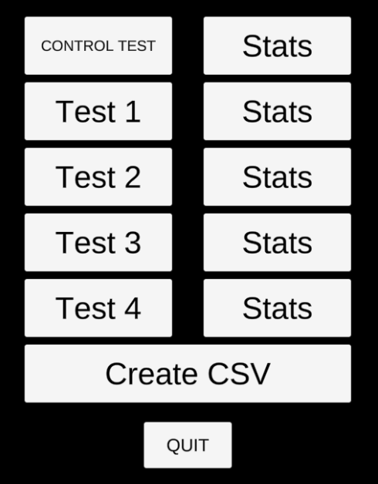
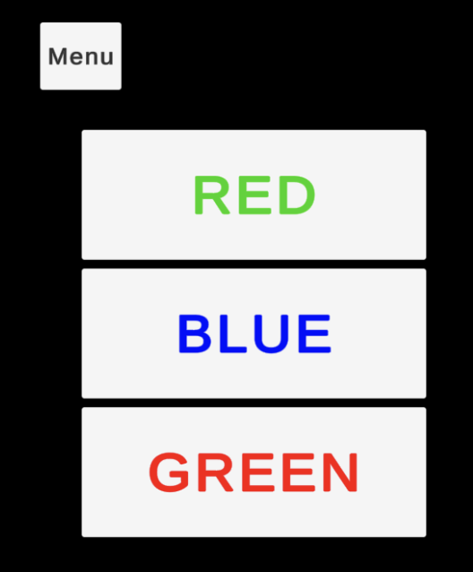
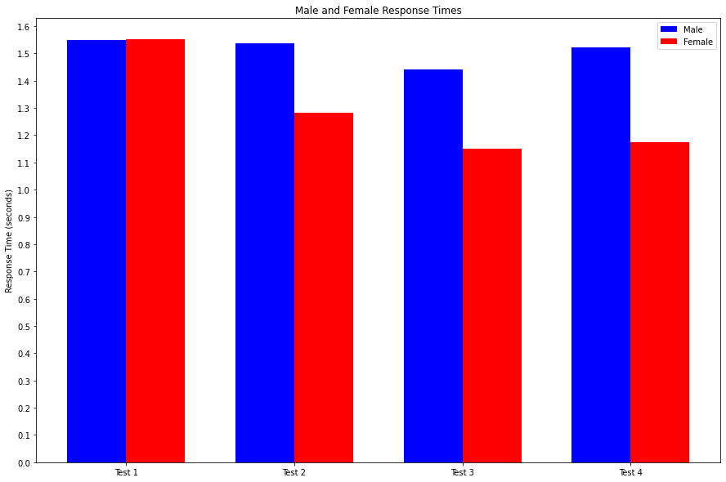
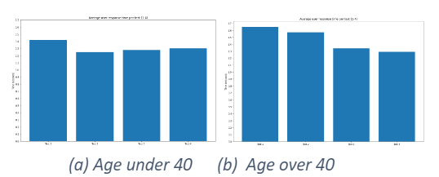
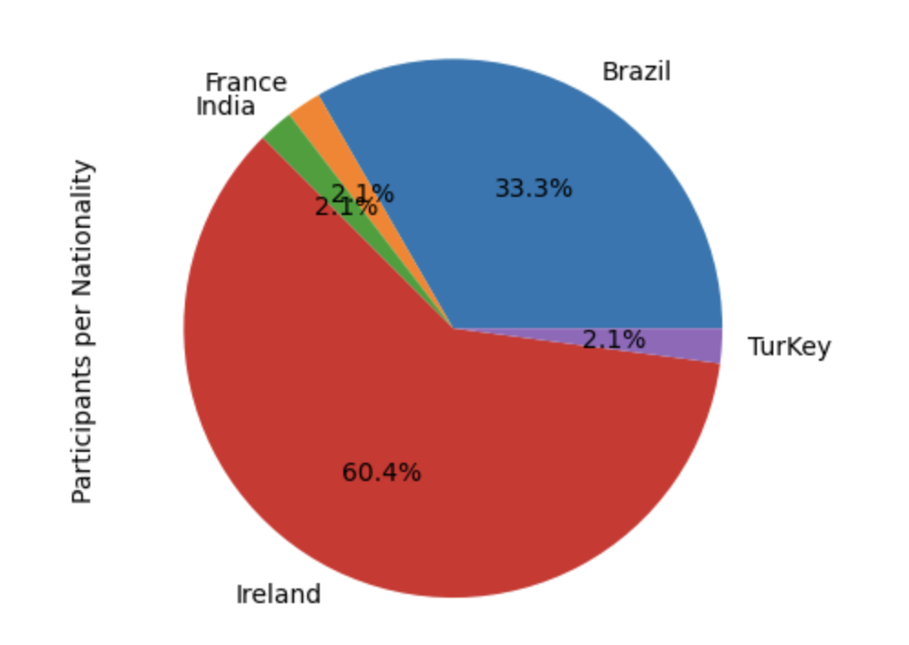
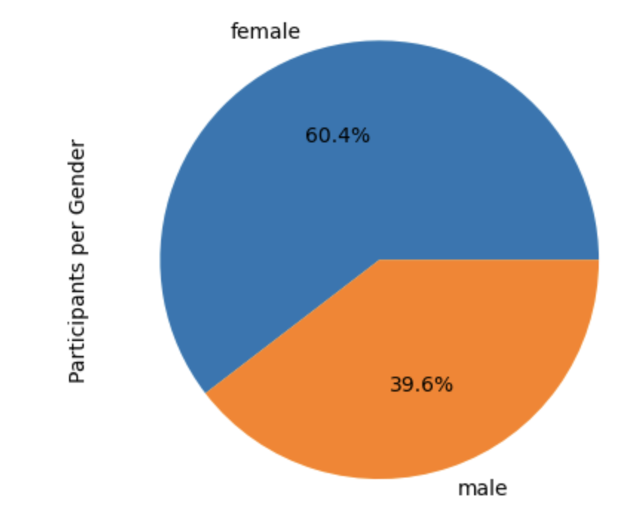
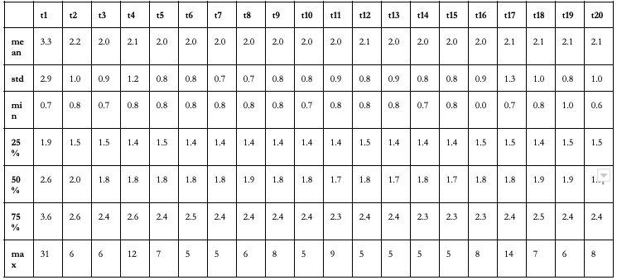
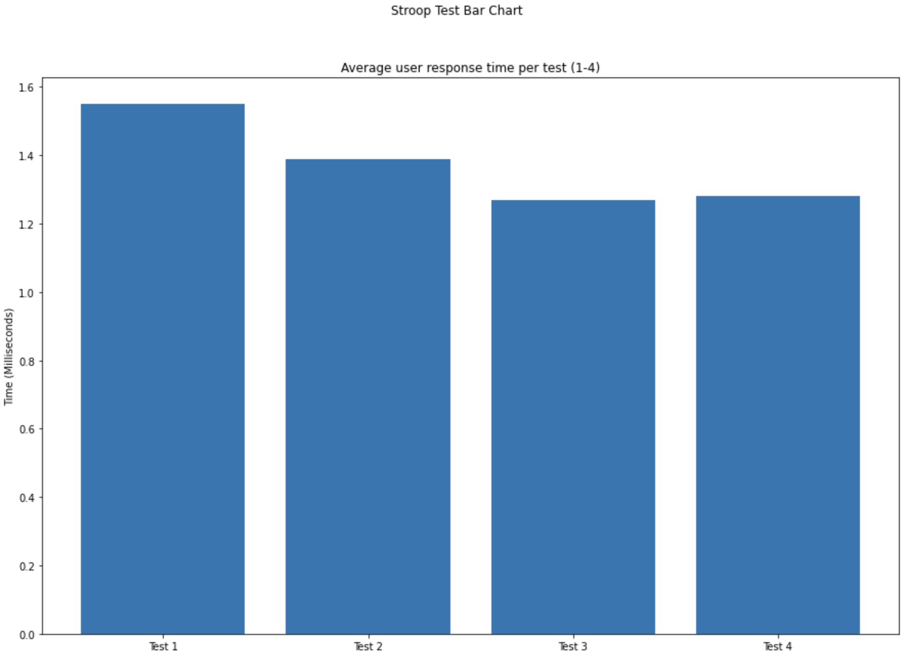
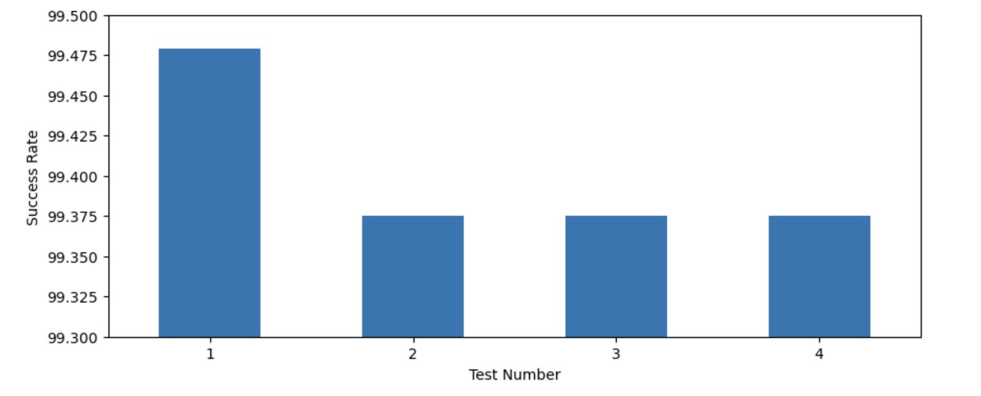
The Impact of Auditory Stimuli on Cognitive Flexibility: An Investigation of the Stroop Test
Abstract
The four Stroop tests show a list of three words, where two of them are incongruent and only one is congruent. The examinee should select the congruent option. For each test a list of words is presented 20 times (Fig 2), varying each time in both word font colouring and position. Each of the four tests is accompanied by a selection of different auditory stimuli. For each participant the application records the demographic, response time, and success rate of each test.
Majority of participants are female and from Ireland, as we can see on Fig 3.
Figure 3 - Participants by nationality and gender
Table 1 presents the main metrics of the response times for tests 1, 2, 3 and 4. The min and max times are wide ranging from between 0.7s and 31s. With many users notably displaying poor response times at the beginning of tests, it was decided that only the remaining 18 times would be used to gauge performance.
After removing the first two attempts for each test, the average of the response time among tests is between 1.2 seconds and 1.6 seconds. In Fig 4 we can see that user response times tend to decrease as the test proceeds, with a slight increase on test 4 (spoken word audio). One reason for this general improvement in response times may be down to users becoming more familiar with the test format as the test proceeds.
As visible in Fig 5, users displayed the highest accuracy on test 1, which is the only test without accompanying audio, suggesting that a silent environment contributes to a lower error rate. For tests 2, 3 and 4 users achieved a lower average success rate, which could indicate that auditory stimuli may contribute to poorer performance.
Participants were subjected to a variety of Stroop-like tests with accompanying audio. Response times were catalogued and contrasted to examine the effects of audio on participants. Reported response times improved as the test proceeded, although further analysis showed that there were some minor differences in performance between genders and age groups, implying that this could be an area worthy of further research.
Figure 1 - Initial screen
Figure 2 - Test example
Figure 6 - Response time metrics for gender
Test times were further analysed but considering only test results with a 100% success rate (Fig 6). These test results show that females performed on average quicker than their male counterparts. The findings may suggest that men and women’s cognitive abilities can be affected by differing environmental auditory stimuli.
Figure 7 - Response time metrics for age
Finally, user response times were analysed by age group with Fig 7(a) showing performance for users under the age of 40 and Fig 7(b) showing results for users over 40.
Introduction
Many modern day workplaces are environments surrounded with outside influences and distractions. The effect of audio on cognitive ability is not known to a full extent. This investigation aims to shed some light on how human cognition is affected, either positively or negatively, by different audio stimuli. Cognitive ability is measured against the Stroop test and a range of accompanying audio. User success rate, response time, and feedback is recorded. Test data is analysed to observe and contrast performance during each of the four tests, in order to determine which audio environment is least/most beneficial to cognitive performance.
Results
Literature Review
The Stroop effect is a psychological experiment that was originally designed by John Ridley Stroop in 1935 [4]. The study consisted of individuals reading a sequence of the words red/green/brown/purple or naming the colours the words were written in. The words were not printed in the colour that they are named, instead they were printed in one of the other three colours. For example, the word red could be printed in green. Consequently, two stimuli are presented at the same name; the word and the colour.
Words were also printed in black and the colours were also presented in squares/swastikas. The reading stimuli was measured focusing on the time difference between reading the coloured word and reading the same word written in black ink. The naming of colour stimuli was measured considering the time difference between naming colours from words and same colours from squares/swastikas.
Stroop [4] concluded that the colour stimuli doesn’t significantly affect the time for reading words, however the word stimuli caused an increase of 74.3% in naming colours.
According to [2], our life is full of distractions on a daily basis. Some can be easily ignored while others not so much. One such example is auditory distraction which can affect our cognitive process.
However, as mentioned earlier [1], there are studies that differ on how noise affects cognitive performance, with some arguing that this can bring about positive results, while others believing it to have a negative impact. This is the main factor that motivated this study; to investigate how the results of Stroop test can be affected due to external audio/distractions.
Since the original Stroop was presented, many other variations have been developed. For example, the Auditory Stroop tests, where audio is introduced to the experiment. Steven et al [3] investigated gender associations in adults and children using Stroop tests, in which participants were asked to categorise the gender of voices while being presented with gender-stereotypical words (e.g., dress) and names (e.g., Peter). These studies introduced audio to the experiment, but they did not evaluate the impact of trivial noises, like conversations, music, traffic, etc, on traditional Stroop test results.
Conclusion
Test success rate indicates that participants performed best on test 1 (no audio distractions). Some marginal differences were noted between gender and age response times, which suggests that there may be grounds for further investigation into how we are affected by environmental auditory stimuli.
It should be mentioned that in most cases participants performed the tests without supervision, which could affect the results, since there is no guarantee that the user was not distracted by other stimuli.
Table 1 - Response time metrics
Future Work
Implement a Web Application where data would be saved directly to an online database. This improvement removes the dependency of the user local environment and avoids the work of having to merge all files.
Future analysis could be carried out on new and existing data in order to research if there is a link to performance times and native speaking language. There is also room to increase the difficulty of the Stroop test application to include four colour options instead of just three.
The experiment could be repeated in a controlled environment where participants are supervised.
Another experiment can be performed to analyse the attention control of participants diagnosed with Autism Spectrum Disorder (ASD) and participants not diagnosed with any disorder.
Figure 4 - Average user response time per test
References
[1] Jafari MJ at el. The Effect of Noise Exposure on Cognitive Performance and Brain Activity Patterns. Open Access Maced J Med Sci. 2019 Aug 30;7(17):2924-2931. doi: 10.3889/oamjms.2019.742. PMID: 31844459; PMCID: PMC6901841.
[2] Lavie, N. (2010). Attention, Distraction, and Cognitive Control Under Load. Current Directions in Psychological Science, 19(3), 143–148. doi: https://doi-org.ezproxy.ait.ie/10.1177 /0963721410370295
[3] Steven B. Most, Anne Verbeck Sorber, Joseph G. Cunningham. Auditory Stroop reveals implicit gender associations in adults and children. Journal of Experimental Social Psychology, Volume 43, Issue 2, 2007, Pages 287-294, ISSN 0022-1031. doi: https://doi.org/10.1016/j.jesp.2006.02.002.
[4] Stroop, J. R. (1935). Studies of interference in serial verbal reactions. Journal of Experimental Psychology, 18(6), 643–662. doi: https://doi.org/10.1037/h0054651.
Test Configuration
The experiment consists of two questions regarding users’ age and gender, a control test and four different environmental tests. Fig 1 illustrates the initial screen. At the beginning of the experiment, a control test is given to ensure the examinee’s comprehension about how tests work and also to determine the participant’s baseline reaction time.
Figure 5 - Success rate per test

